Slide 1
Woodland Public Schools
Facilities and Safety Report
August 2019

Slide 2
FACILITIES REPORT
Bleed Control Kits
Bleed Control Kits were added to all of the AED lockers at all 5 schools in the District. A total of 15 kits will be distributed. Life threatening bleeding can occur from everyday emergencies and incidents, including natural and man-made disasters. Bleed Control Kits are designed to provide essential equipment that empowers responders to take action immediately to stop life threatening bleeding. The kits provide intuitive and easy-to-use tools that are proven to help to save lives such as one of the fastest, safest, and most effective tourniquets made. Gauze, shears, pressure dressings/bandages, and a compact chest seal for chest wounds are included in this kit. Also included are step-by-step illustrated “just in time” pictorial instructions, so even untrained providers can help save a life.
School Realignment
School realignment work went relatively well with all of the room to room and school moves completed on the week of June 17. Much of the follow up work revolved around making sure all of the rooms and support areas were sized appropriately for the new aged students. Plumbing fixtures height changes, school signs, and other necessary changes were completed and the schools were ready to receive eager students on the first day of school!
Yale Chlorination
We completed the Yale water chlorination system over the summer and started the system early September. The project included a new pump house, valves, piping and metering pump, and other necessary equipment to properly dose chlorine into the system.

Slide 3
FACILITIES REPORT
Portables
A ton of work was completed on all of the portables at Columbia. The work included the complete interior renovation for portables 4, 5, 6, and 7. Portable 4 was reconfigured for the new art room and portable 5 was configured for the new computer lab. Portable 4/5 also had restrooms installed in each classroom. Portable 6/7 was reconfigured as the new preschool portable. All new interior finishes were completed including paint, flooring, lighting, and electrical upgrades. FCRC was moved from 6/7 to 8/9.
Exterior Painting
Odie, our District painter had another very productive summer. He continued with the exterior painting of the WMS campus completing the street side of the Green Hall and Yellow Hall all the way down to the LRA building. We will continue to paint next summer and hopefully wrap up WMS exterior by the end of next summer.

Slide 4
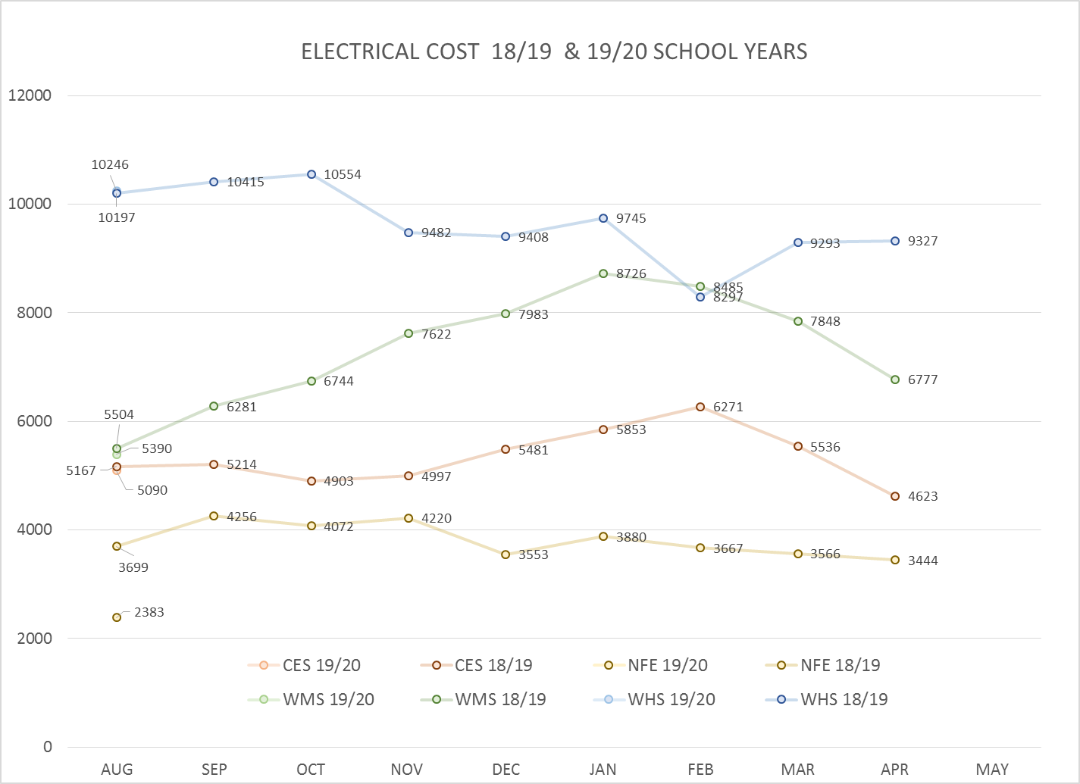
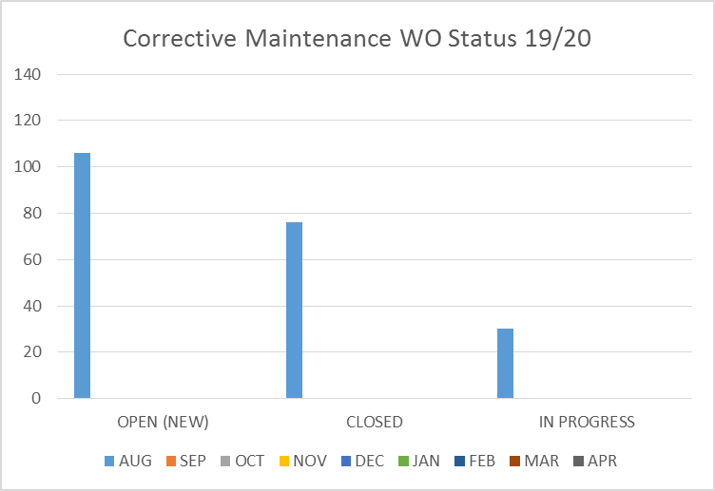
FACILITY CHARTS – POWER COST AND WORK ORDER STATUS

Slide 5
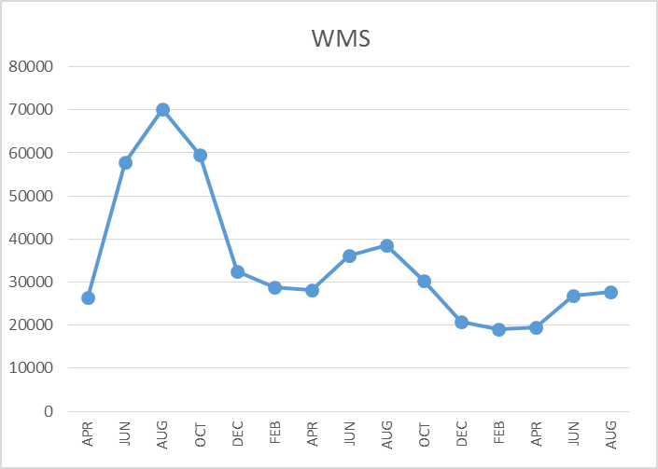
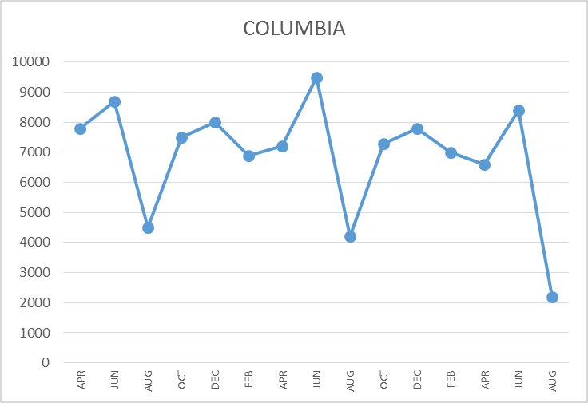
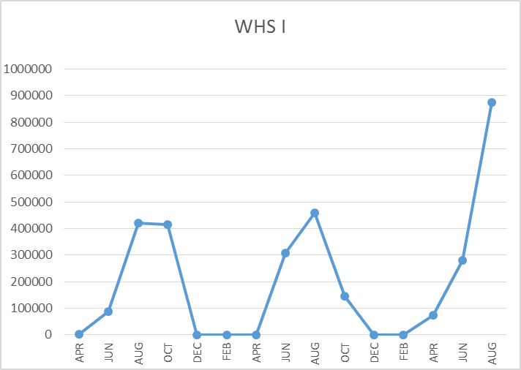
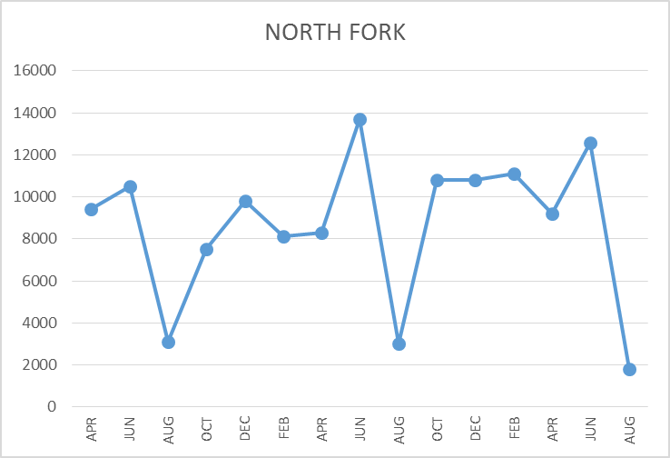
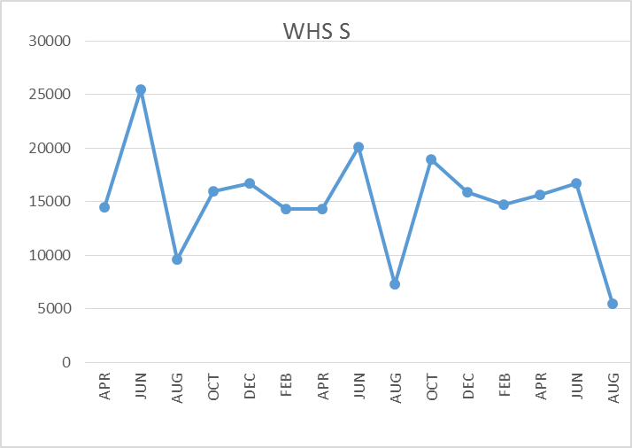
FACILITY CHARTS – WATER USAGE WHS, North Fork Elementary, WMS, Columbia Elementary
Note
Water charts are updated every two
months. Next update to these charts
in November 2019.
The WHS irrigation system
had underground leak. Billing
was adjusted from
$24,844 to $9690.(representing historical usage)
The WMS chart has been reconfigured to include the following 7 meters: 755 Park high and low flow, BO and Team High, PIT house, bus barn, athletic field and DO. All of these meters are totaled on the WMS graph, but each data point is recorded separately to aid in identifying leaks.

Slide 6
Accident/Incident Summary (27-29 August)
Accidents for the Month
There was 1 accident/incident for the month.
Staff Accidents/Incidents (1)
WMS – Bookshelf failed when loading books. Employees was struck by falling books and shelf.
Student Accidents/Injuries
None

Slide 7
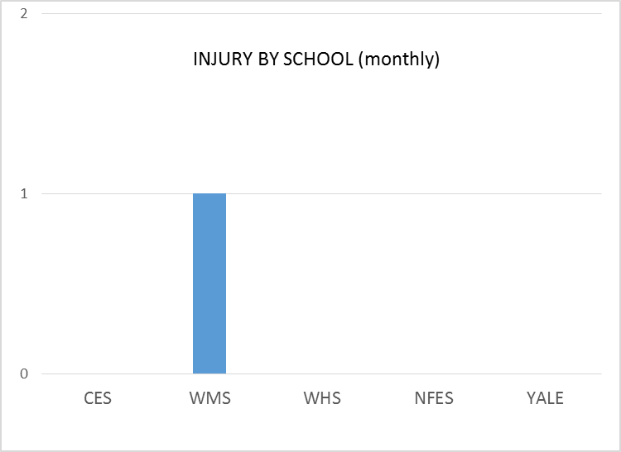
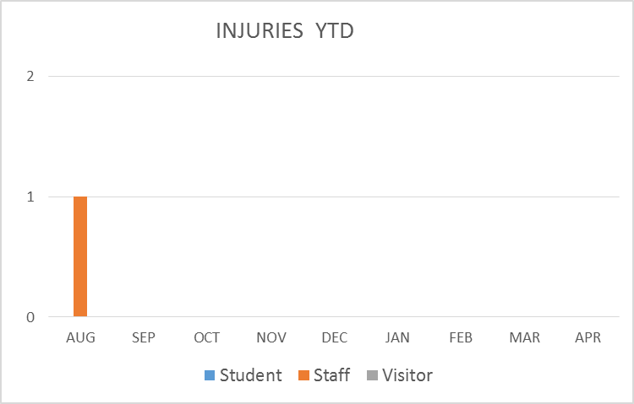
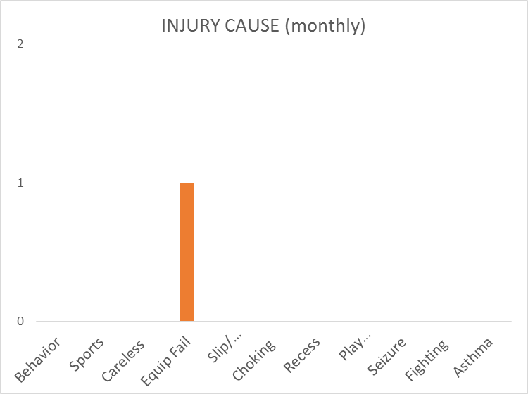
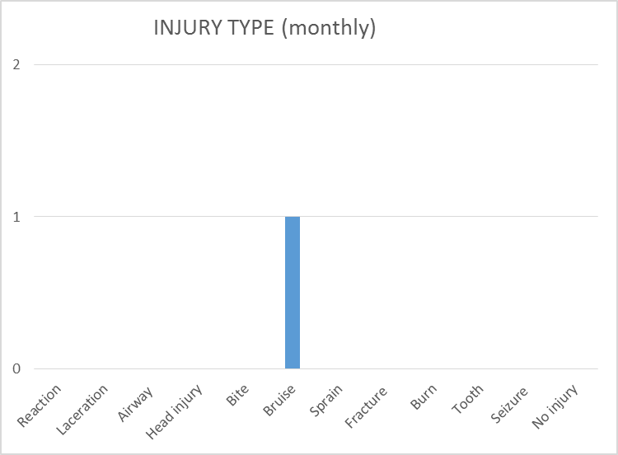
SAFETY
CHARTS

